Slide 1
Channel Models

Slide 2
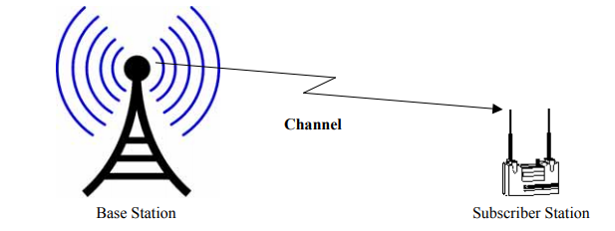
Channel
The term channel refers to the medium between the transmitting antenna and the receiving antenna as shown in Figure
The characteristics of wireless signal changes as it travels from the transmitter antenna to the receiver antenna.
These characteristics depend upon the distance between the two antennas, the path(s) taken by the signal, and the environment (buildings and other objects) around the path.
The profile of received signal can be obtained from that of the transmitted signal if we have a model of the medium between the two. This model of the medium is called channel model.

Slide 3
Channel Model
For the design, simulation, and planning of wireless systems, we need models for the propagation channels
There are two main applications for channel models:
For the design, testing, and type approval of wireless systems, we need simple channel models that reflect the important properties of propagation channels – i.e., properties that have an impact on system performance. The number of parameters is small and independent of specific location
The designers of wireless networks are interested in optimizing a given system in a certain geographical region. Locations of Base Stations (BSs) and other network design parameters should be optimized on the computer, and not by field tests, and trial and error. For such applications, location-specific channel models that make good use of available geographical and morphological information are desirable.

Slide 4
Modeling methods
Stored channel impulse responses
measures, digitizes, and stores impulse responses
Deterministic channel models
these models use the geographical and morphological information from a database for a deterministic solution of Maxwell’s equation
Stochastic channel models
these model the probability density function (pdf) of the channel impulse response

Slide 5
Narrowband Models
Modeling of Small-Scale and Large-Scale Fading
For a narrowband channel, the impulse response is a delta function with a time-varying attenuation, so that for slowly time-varying channels:
h(t, τ ) = α(t)δ(τ )
Rayleigh fading
lognormal Fading

Slide 6
Path Loss
The simplest channel is the free space line of sight channel with no objects between the receiver and the transmitter or around the path between them.
The transmitted signal attenuates since the energy is spread spherically around the transmitting antenna.
Line of sight (LOS) channel, the received power is given by:
transmitted power : T-R separation distance (m)
: received power : system loss factor
: transmitter antenna gain : wave length in meters
: receiver antenna gain
The presence of ground causes some of the waves to reflect and reach the transmitter. These reflected waves may sometime have a phase shift of 180° and so may reduce the net received power

Slide 7
The gain of the antenna
: effective aperture is related to the physical size of the antenna
The wave length is related to the carrier frequency by
: carrier frequency in Hertz
: carrier frequency in radians
: speed of light (meters/s)
The losses are usually due to transmission line attenuation, filter losses, and antenna losses in the communication system. A value of L=1 indicates no loss in the system hardware.

Slide 8
Isotropic radiator is an ideal antenna which radiates power with unit gain.
Effective isotropic radiated power (EIRP) is defined as
and represents the maximum radiated power available from transmitter in the direction of maximum antenna gain as compared to an isotropic radiator.
Path loss for the free space model with antenna gains
When antenna gains are excluded
The Friis free space model is only a valid predictor for , for values of d which is in the far-field (Fraunhofer region) of the transmission antenna.

Slide 9
The far-field region of a transmitting antenna is defined as the region beyond the far-field distance
where D is the largest physical linear dimension of the antenna.
To be in the far-filed region the following equations must be satisfied
and
Furthermore the following equation does not hold for d=0.
Use close-in distance and a known received power at that point
or

Slide 10
Path Loss Models
models for the received field strength, averaged over both small-scale and the large-scale fading.
The Okumura–Hata Model
The Okumura–Hata model is by far the most popular model in that category. Path loss (in dB) is written as
PL = A + B log(d) + C
where A, B, and C are factors that depend on frequency and antenna height.
Factor A increases with carrier frequency and decreases with increasing height of the BS and Mobile Station (MS).
Also, the path loss exponent (proportional to B) decreases with increasing height of the BS
The model is only intended for large cells, with the BS being placed higher than the surrounding rooftops

Slide 11
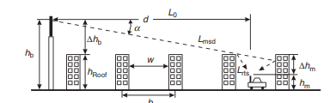
The COST 231–Walfish–Ikegami model
suitable for microcells and small macrocells, as it has fewer restrictions on the distance between the BS and MS and the antenna height
In this model, total path loss consists of the free space path loss PL₀, multiscreen loss L_{msd} along the propagation path, and attenuation from the last roof-edge to the MS, L_{rts} (rooftop-tostreet diffraction and scatter loss)

Slide 12
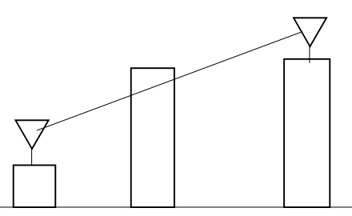
Shadowing
If there are any objects (such buildings or trees) along the path of the signal, some part of the transmitted signal is lost through absorption, reflection, scattering, and diffraction. This effect is called shadowing.

Slide 13
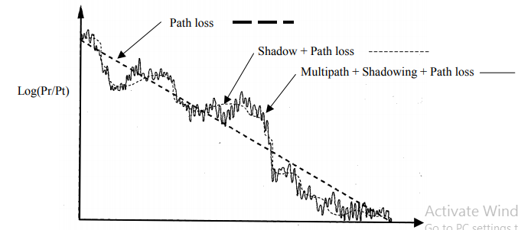
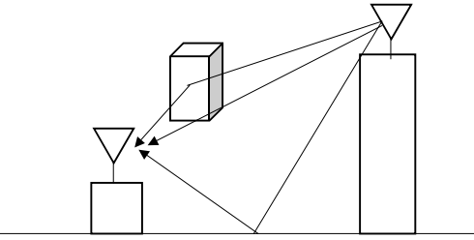
Multipath
The objects located around the path of the wireless signal reflect the signal. Some of these reflected waves are also received at the receiver. Since each of these reflected signals takes a different path, it has a different amplitude and phase.
Depending upon the phase, these multiple signals may result in increased or decreased received power at the receiver. Even a slight change in position may result in a significant difference in phases of the signals and so in the total received power.

Slide 14
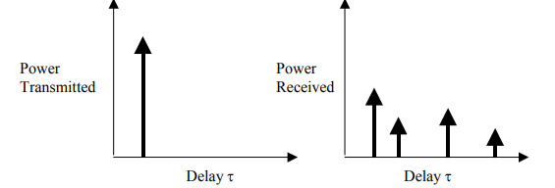
Multipath Power Delay Profile
Since different paths are of different lengths, a single impulse sent from the transmitter will result in multiple copies being received at different times as shown in Figure

Slide 15

Models for the Power Delay Profile
It has been observed in many measurements that the Power Delay Profile (PDP) can be approximated by a one-sided exponential function:
The delay spread is a function of the distance BS–MS, increasing with distance approximately as dε, where ε = 0.5 in urban and suburban environments, and ε = 1 in mountainous regions.
The delay spread also shows considerable large-scale variations.
The delay spread has a lognormal distribution with a variance of typically 2–3 dB in suburban and urban environments

Slide 16
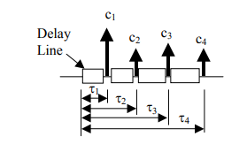

Wideband Models
Tapped Delay Line Models
The most commonly used wideband model is an N-tap Rayleigh-fading model
where the LOS component a₀ does not vary with time, while the c_{i}(t) are zero-mean complex Gaussian random processes, whose autocorrelation function is determined by their associated Doppler spectra. In most cases, τ₀ = τ₁, so the amplitude distribution of the first tap is Rician.
The model is further simplified when the number of taps is limited to N = 2, and no LOS component is allowed.
it is alternatively called the two-path channel, two delay channel, or two-spike channel.
Another popular channel model consists of a purely deterministic LOS component plus one fading tap (N = 1) whose delay τ0 can differ from τ1. This model is widely used for satellite channels – in these channels, there is almost always an LOS connection, and the reflections from buildings near the RX give rise to a delayed fading component. The channel reduces to a flat-fading Rician channel when τ₀ = τ₁,.

Slide 17
Deterministic Channel-Modeling Methods
A wireless propagation channel can be viewed as a deterministic channel.
Maxwell’s equations, together with electromagnetic boundary conditions (location, shape, and dielectric and conductive properties of all objects in the environment), allow determination of the field strength at all points and times.
For outdoor environments, such purely deterministic channel models have to take into account all the geographical and morphological features of a propagation environment
For indoor environments, the building structure, wall properties, and even furniture should be taken into consideration.
To make deterministic modeling a viable option, two major challenges had to be overcome:
(i) the high amount of required computer time and
(ii) the need for exact knowledge of boundary conditions.
The most accurate solution
Method of Moments
Finite Element Method (FEM
Difference Time Domain

Slide 18
Ray Launching
The transmit antenna sends out (launches) rays into different directions. Typically, the total spatial angle 4π is divided into N units of equal magnitude, and each ray is sent in the direction of the center of one such unit. The number of launched rays is a tradeoff between accuracy of the method and computation time.
Free space attenuation: as each ray represents a certain spatial angle, the energy per unit area decreases d−2 along the path of the ray.
Reflections change the direction of a ray and cause an additional attenuation. Reflection coefficients can be computed from Snell’s laws.
Diffraction and diffuse scattering are included in more advanced models. In those cases, a ray that is incident on an IO gives rise to several new rays. The amplitudes of diffracted rays are usually computed from the geometrical or uniform theory of diffraction

Slide 19
Ray Tracing
Classical ray tracing determines all rays that can go from one TX location to one RX location.
The method operates in two steps:
1. First, all rays that can transfer energy from the TX location to the RX location are determined. This is usually done by means of the image principle. Rays that can get to the RX via a reflection show the same behavior as rays from a virtual source that is located where an image of the original source (with respect to the reflecting surface) would be located
2. In a second step, attenuations (due to free space propagation and finite reflection coefficients) are computed, thus providing the parameters of all MPCs.

Slide 20
Efficiency Considerations
To reduce the computational effort
Indoor: indoor environments practically always require three-dimensional considerations. Even when the BS and the MS are on the same floor, reflections at floors and ceilings represent important propagation paths.
Macrocells: by definition, the BS antenna is considerably above the rooftops. Propagation thus occurs mostly over the rooftops to points that are close to the MS. From these points, they then reach the MS, possibly via a diffraction or a reflection from the wall of the house opposite. Ray tracing in the vertical plane alone can thus be sufficient for some cases. This is especially true when ray tracing should only predict the received power and delay spread. On the other hand, such a purely vertical ray tracing will not correctly predict the directions of the rays at the MS.
Microcells, small distance BS–MS: as both BS and MS antennas are below the rooftop, the diffraction loss of over-the-rooftop propagation is large. Propagation in the horizontal plane – i.e., through street canyons – can be a much more efficient process. Under these conditions, ray tracing in just the horizontal plane can be sufficient.
Microcells, large distance BS–MS: in this case, the relative power of rays propagating in the horizontal plane (compared with over-the-rooftop components) is smaller. Horizontal components undergo multiple diffraction and reflection processes, while losses from over-the-rooftop components are mostly determined by diffraction losses near the BS and the MS, and thus depend less on distance.

